Slide 1

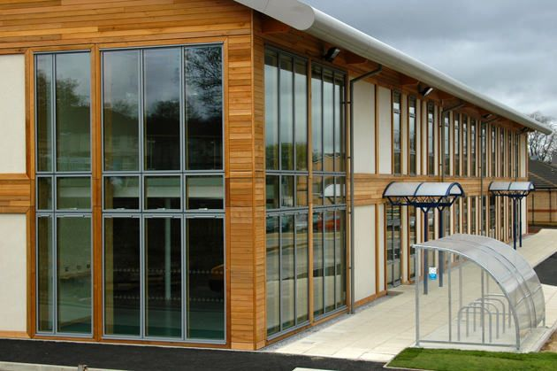
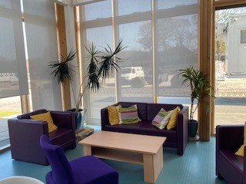


We are recruiting a part-time receptionist
We are looking for an experienced part-time receptionist to join our team.
Monday - Friday 8.30am to 1pm.
Working across reception and our in-house café, we are looking for a team player with the right attitude and personality.
If interested, please email a covering letter and CV to: Info@newlandsca.org.uk
Closing date: Monday 20th July 2026

