Slide 1

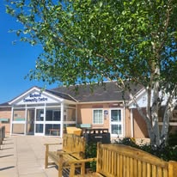
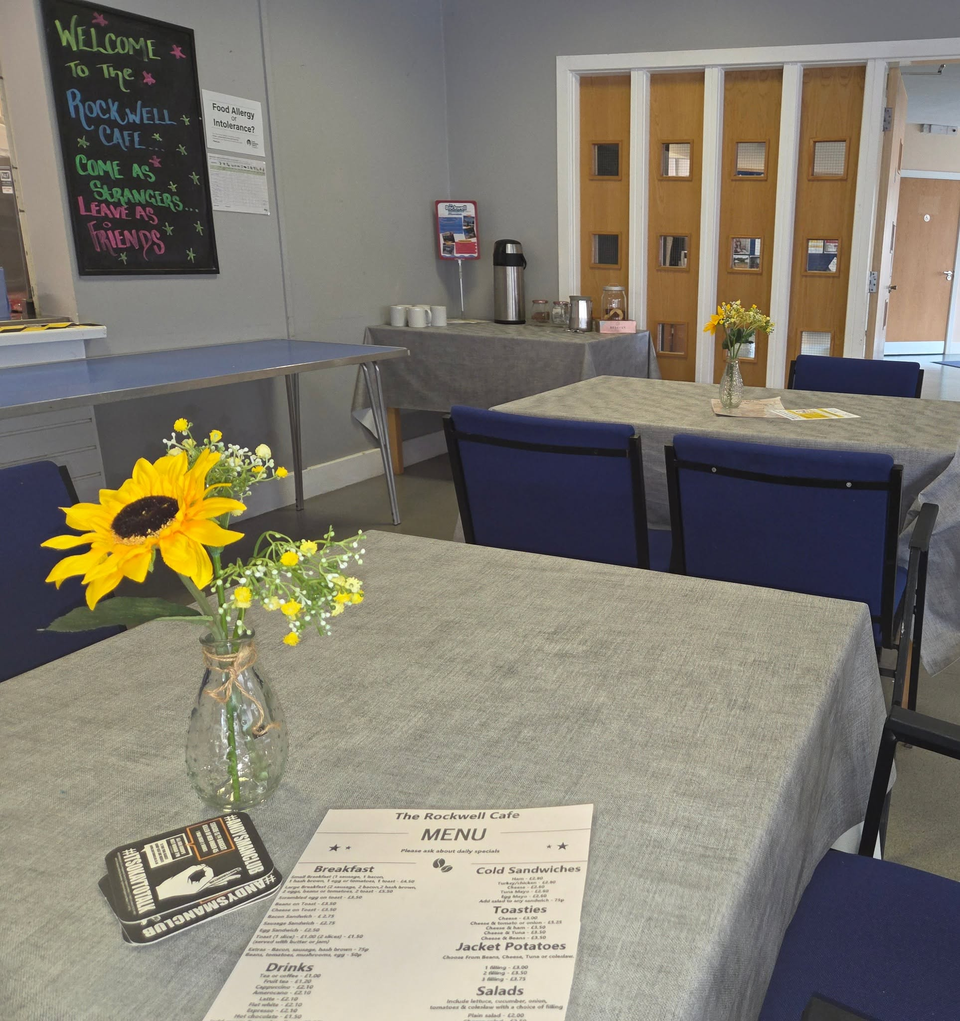

We are recruiting a part-time Café Worker
We are looking for an experienced part-time Café Worker for the Rockwell Centre.
Monday – Thursday 9.30am to 2.30pm.
Preparing and serving meals for the community and groups using the centre.
If interested, please email a covering letter and CV to: Info@newlandsca.org.uk
Closing date: Monday 20th July 2026

